Slide 1
CSE-101
History of Computers

Slide 2
Notable History
Computers were initially large machines that could fill entire rooms. Some were operated using large vacuum tubes that formed the basis of today's transistors. In order to operate such machines, punch cards were used. One of the first such examples of this was the Jacquard Loom. In 1833 Charles Babbage invented his difference engine, an early calculator. Together with the punch card design, he created the analytical engine. Regrettably the engine never saw completion due to political issues.
Over time computers became more and more powerful, with the introduction of the ubiquitous microprocessor driving forward development. Gordon Moore, one of the co-founders of Intel, invented Moores law, which predicted that the number of transistors that could be placed on an integrated circuit inexpensively doubled every 2 years. This law has held true to a certain degree, and it can be seen in motion every day with the introduction of more and more powerful microprocessors and larger hard drives and memory modules.

Slide 3
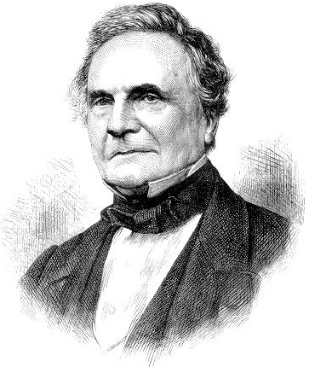
Charles Babbage, who is accredited with first conceptualizing the programmable computer

Slide 4
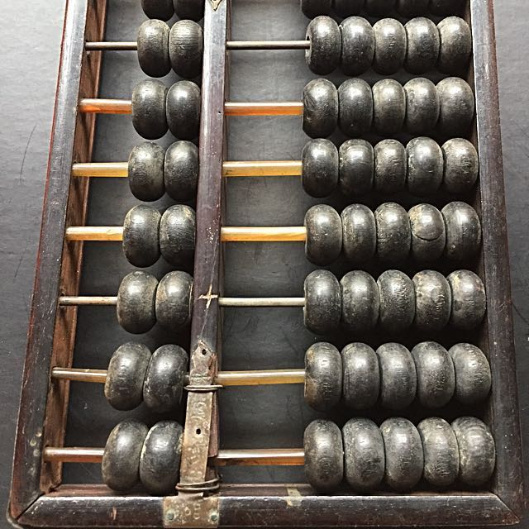
Abacus
The abacus, also called a counting frame, is a calculating tool that was in use in the ancient Near East, Europe, China, and Russia, centuries before the adoption of the written Hindu–Arabic numeral system. The exact origin of the abacus is still unknown

Slide 5
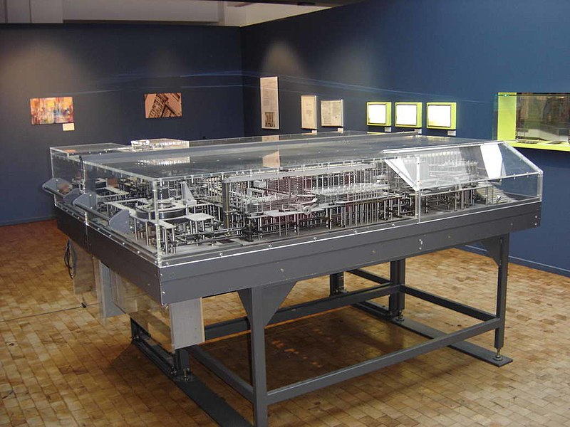
Z1
The Z1 was a mechanical computer designed by Konrad Zuse in 1935 and first built in 1936. It was a binary electrically-driven mechanical calculator with limited programmability, reading instructions from punched tape.

Slide 6
ENIAC
A behemoth of a machine weighing 27 tonnes, ENIAC stood for Electrical Numerical Integrator and Computer. Originally planned for use in calculating artillery firing tables, on completion in 1946 its first tasks were to perform calculations for hydrogen bomb design. The ENIAC used thousands of vacuum tubes and a punch card mechanism. Working out the programming on paper took weeks, and performing the necessary wiring took days. The ENIAC saw service until October 2, 1955

Slide 7
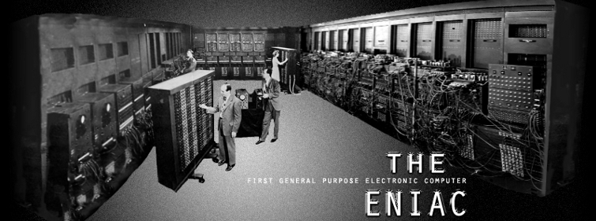

Slide 8
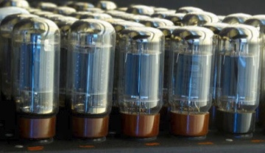

Slide 9
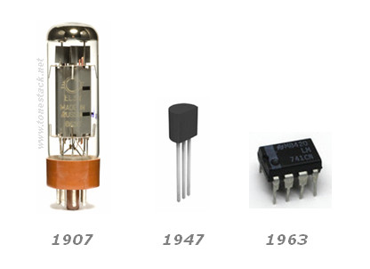
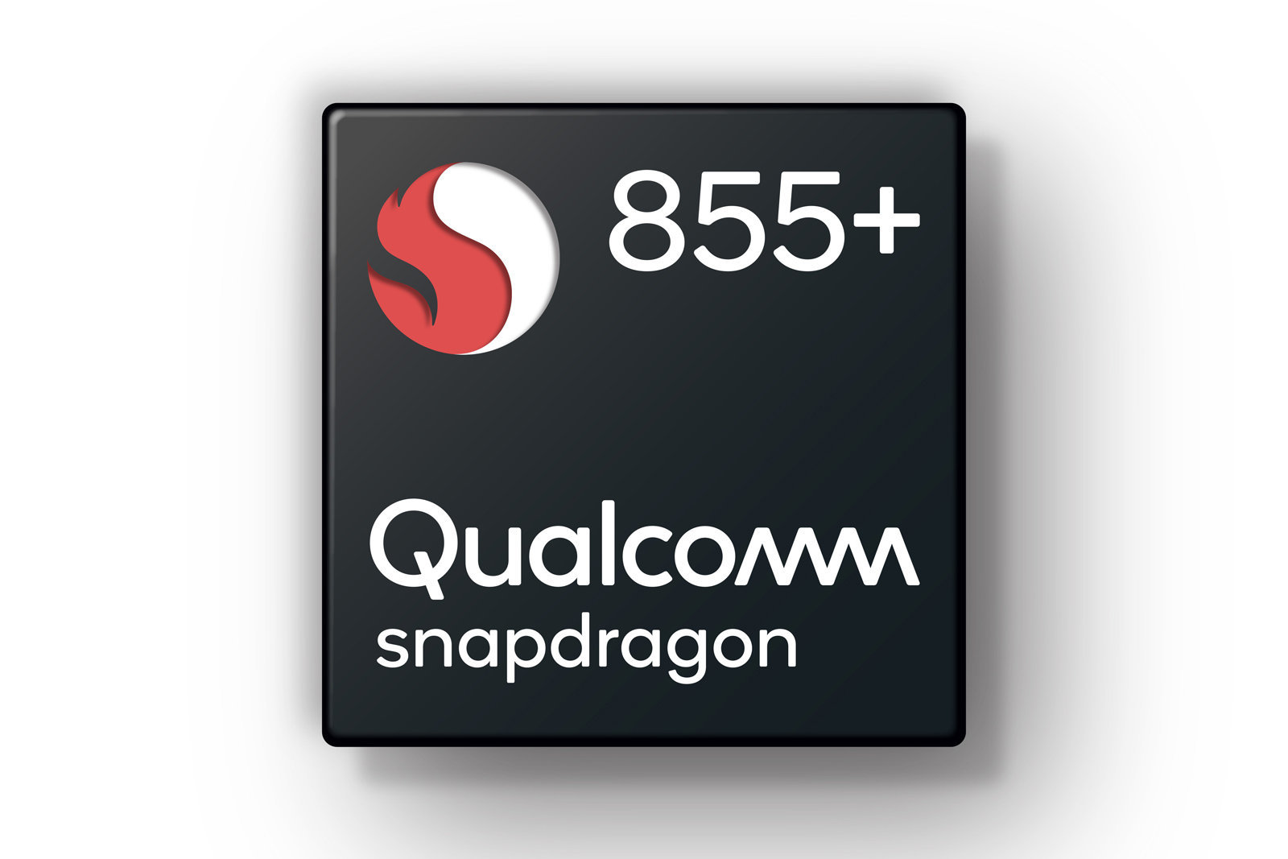
2019

Slide 10
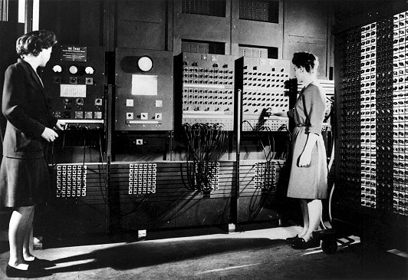
Programming ENIAC
Francis & Jean

Slide 11
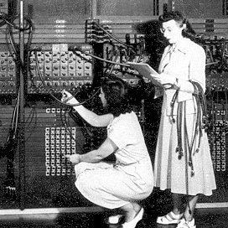

Slide 12
AltAir 8800
A microcomputer design from 1975, the Altair is considered to have started the personal computer revolution. It was the target of Microsoft's first product: a programming language called Altair Basic. The computer was sold as a kit requiring assembly by the user, although pre-assembled kits could be bought for a higher price. The Altair defied sales forecasts by selling thousands instead of hundreds to computer hobbyists, accelerating a growing hacker culture.

Slide 13
Macintosh
First introduced by Apple in 1984, the Macintosh was the first popular computer to use a mouse and graphical user interface (GUI) rather than a command line interface, and was initially used primarily as a desktop publishing tool.
https://youtu.be/OYecfV3ubP8

Slide 14
IBM
The granddaddy of all current personal computers, the IBM PC was introduced in 1981. It was capable of running 3 different operating systems at launch, the most popular being PC DOS. Because of its success, many manufacturers were encouraged to create clones with the same feature set as the PC, which we use today as our computers.

Slide 15
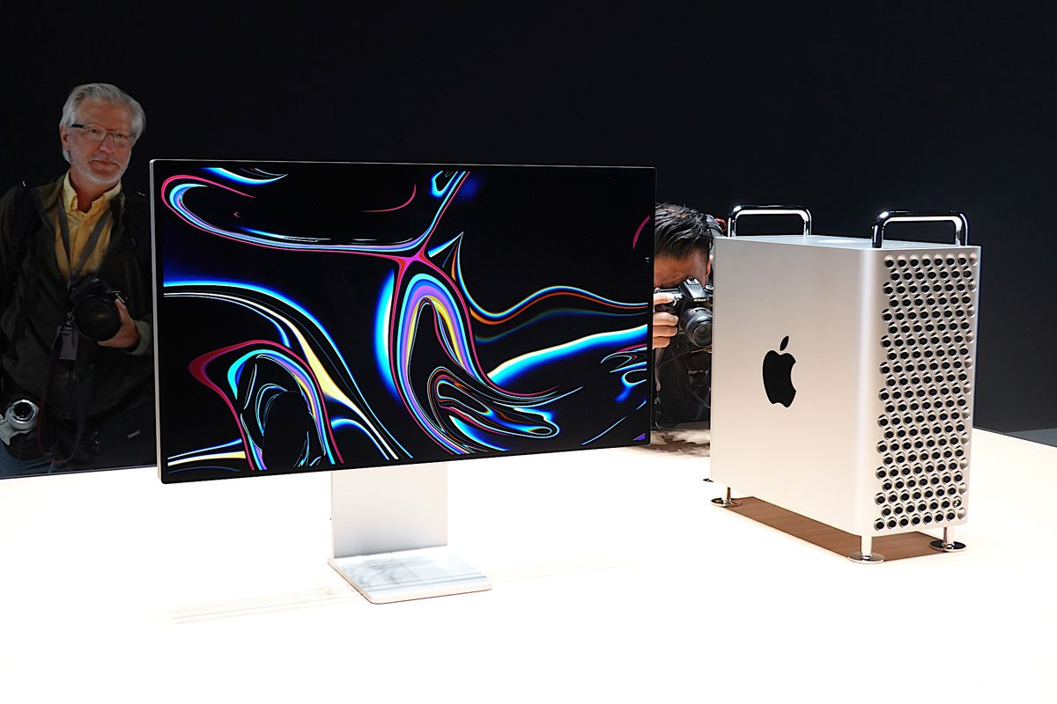
And Now!!!

